Slide 1
Natural Selection
Principals of Natural Selection
Case Studies of Natural Selection
Types of Natural Selection

Slide 2
Evolution
Mutation
Non-random changes to allele frequency of population
Random changes to allele frequency of population
Variation in Gene Pool
Variation in Populations
Natural Selection
Sexual Selection
Artificial Selection (Selective breeding)
Genetic Drift
Bottleneck Effect
Founder Effect
Mechanisms of Evolution
Microevolution
Gene Flow

Slide 3
Syllabus:
Natural selection occurs when selection pressures in the environment confer a selective advantage on a specific phenotype to enhance its survival and reproduction; this results in changes in allele frequency in the gene pool of a population
Describe how selection pressures result in evolution (Natural Selection)
Heredity
Essential
Question:
BIOLOGY WA UNITS 3&4
Chapter 9 Mechanisms of Evolution and Speciation pg. 293-308
Questions
Set 9.2 pg. 296 Q 1-4
Set 9.3 pg. 304-305 Q 1-6
Set 9.4 pg. 307 Q 1-4
Set 9.5 pg. 308 Q 1-4
BIOZONE Activity Number:
Population Genetics
Activity Number: 203, 204, 205, 206, 207, 208, 209, 211, 212, 213, 215, 216, 217, 218, 219, 220, 221,
Topic Question 1:
Define the following terms: evolution, theory of evolution and mechanisms
Term | Definition
Evolution
Theory of Evolution
Mechanisms

Slide 4
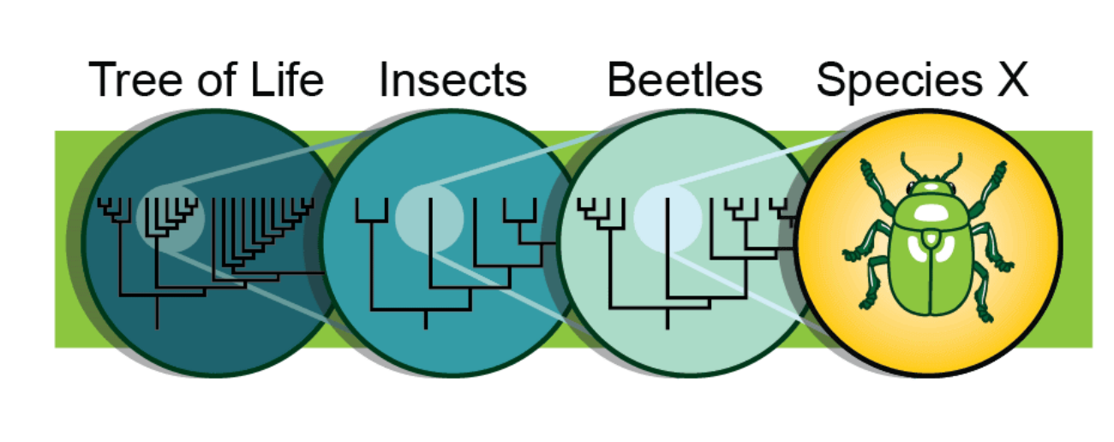
Topic Question 2:
State the four mechanisms of evolution
Four mechanisms of evolution
Topic Question 3:
Define the term microevolution

Slide 5
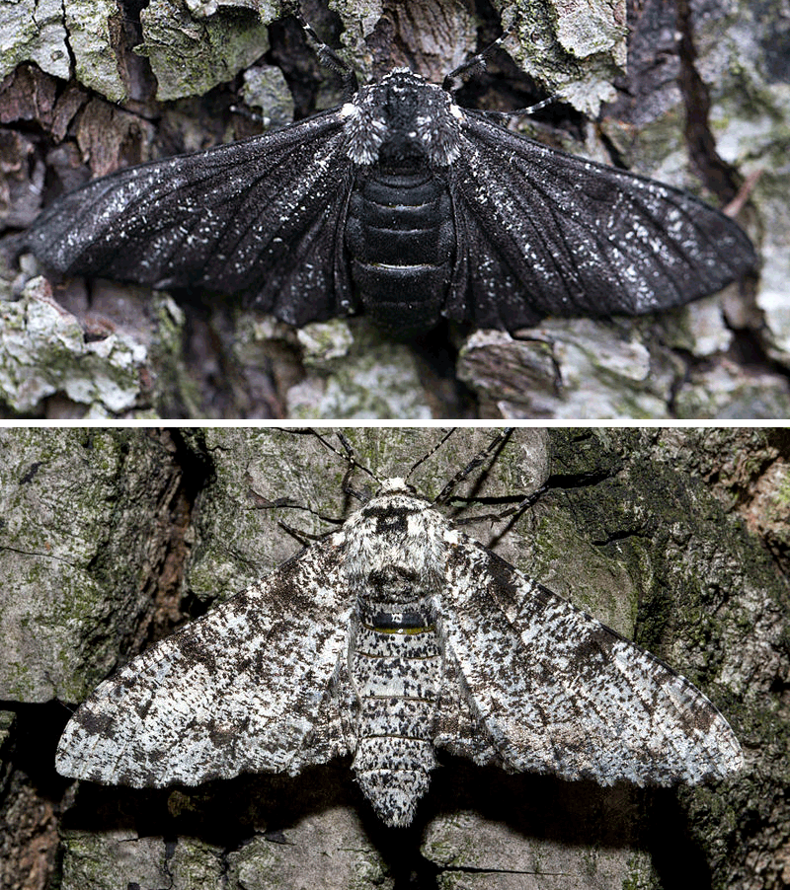
Topic Question 4:
Describe how mutation is a mechanism for evolution
Topic Question 5:
Define the term selection pressure

Slide 6
Topic Question 6:
State the section pressures and organism may experience in its environment
Selection pressures in
an environment
Topic Question 7:
Using an example describe what is meant by the term, selection pressure

Slide 7
Topic Question 8:
Mutation is the ultimate source of variation in a population. Explain how mutations contribute to variation in a population
Topic Question 9:
Describe the gene pool of a population

Slide 8
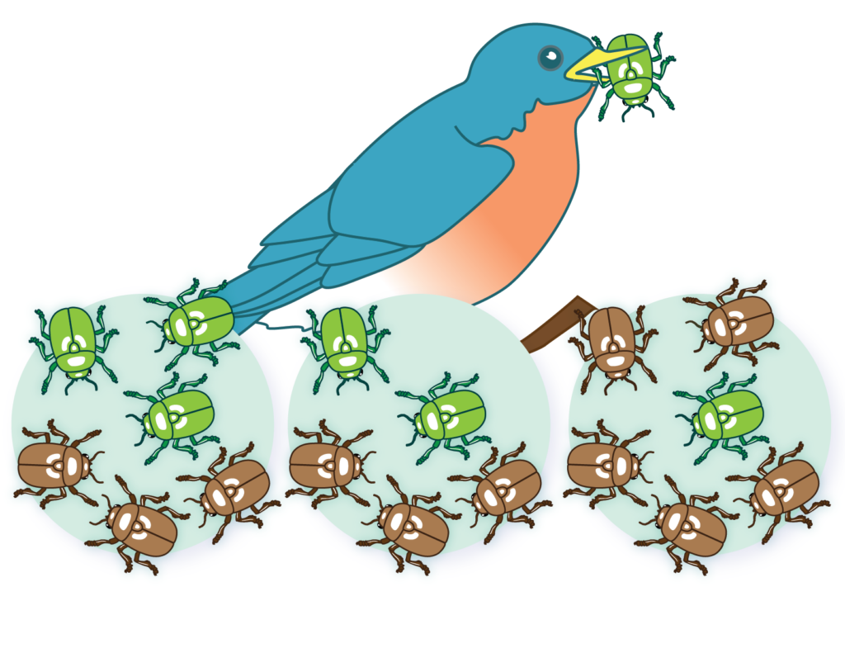
Topic Question 10:
Define the terms Natural Selection and Survival of the Fittest
It leads to changes in allele frequency in the gene pool of a population.

Slide 9

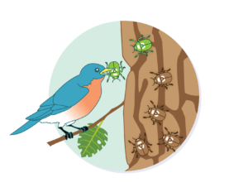
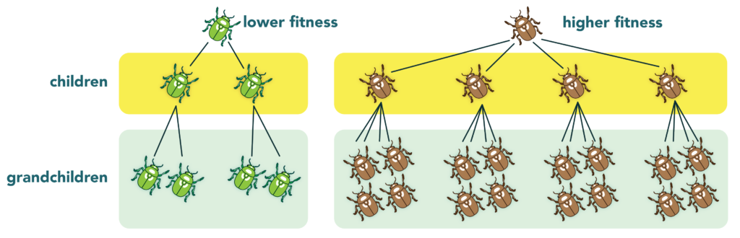
Topic Question 11:
Describe the principals of Natural Selection
Principal | Description

Slide 10
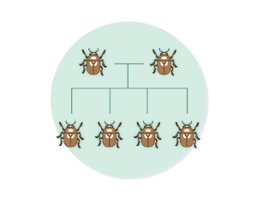
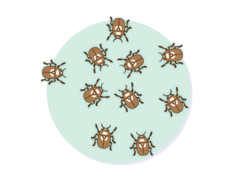
Topic Question 11:
Describe the principals of Natural Selection
Principal | Description

Slide 11
Topic Question 12:
Summarise Natural Selection

Slide 12
Topic Question 13:
Research a case study of Natural Selection and complete the table to show how it demonstrates the principals of Natural Selection
Example and Brief Description | More Offspring than will Survive (overproduction) | Variation | Selection Pressures | Who survives and breeds? | Potential Consequences
Antibiotic Resistant Bacteria
Glyphosate Resistant Weeds

Slide 13
Topic Question 13:
Research a case study of Natural Selection and complete the table to show how it demonstrates the principals of Natural Selection
Example and Brief Description | More Offspring than will Survive (overproduction) | Variation | Selection Pressures | Who survives and breeds? | Potential Consequences
Bt resistance
DDT Resistance

Slide 14
Topic Question 13:
Research a case study of Natural Selection and complete the table to show how it demonstrates the principals of Natural Selection
Example and Brief Description | More Offspring than will Survive (overproduction) | Variation | Selection Pressures | Who survives and breeds? | Potential Consequences
Peppered Moth
Tuskless Elephants

Slide 15
Topic Question 14:
Using examples, describe the three types of natural selection
Type of Natural Selection | Graph | Description | Explain how example shows the type of selection

